Slide 1
HT3 Year 7: Romantic Poetry
Knowledge Organiser
Context
The Romantic Movement is from 1785-1832.
Key Vocabulary
Anaphora A repeated words or phrase at the beginning of a number of lines or sentences: ‘I have a dream’ | Intellectual To do with thinking about, and understanding things, especially complicated ideas | Romanticism The Romantic period was an artistic and intellectual movement which believed in and valued nature, intuition, truth, beauty, emotions, the power of the individual, childhood innocence, experience, imagination
Assonance repetition (or very close similarity) of vowel sounds, e.g. “slice of ice” | Metaphor To say something is something else, not literally true, e.g. it’s raining cats and dogs | Simile When you compare something to something else using ‘like’ or ‘as’
Classicalism A movement in literature & art during the 17th and 18th centuries in Europe which favoured traditional ideas, reason, simplicity, rationality, restraint & strict forms | Ode A type of poem often dedicated to a particular subject | Sonnet – a 14 line poem, often about the topic of love. It has a strict rhyme scheme and rhythm.
Couplet A pair of lines in a poem, usually next to each other. Often they have the same number of syllables and rhyme. | Pastoral Portrays an idealised version of country life | Stanza A ‘paragraph’ or verse in a poem. It has no set number of lines.
enjambment A line in poetry that doesn’t have any punctuation at the end and ‘runs on’ to the next line. | Personification When an object that isn’t human is given human characteristics – daffodils dance, the tree’s fingers scratch the window | Sublime use of language and description that excites the reader’s thoughts and emotions beyond ordinary experience
enlighten To give someone greater knowledge and understanding about a subject and situation | Rational based in reason, or logic. A sensible idea. | Symbolism the use of symbols to represent ideas e.g. the seasons might represent different stages of life.
Extended metaphor A metaphor that continues for a number of lines or sentences. | Restraint To hold back or control (for this topic, feelings and honesty) | Syllable A part of a word. Romantic has 3 syllables: Ro-man-tic
Infancy Early childhood | Revolution A change or overthrow of a government or social order, in favour of a new system | Theme A big idea in a text, e.g. love, nature, childhood, death, violence, justice
The Romantic Movement The Romantic period was an artistic and intellectual movement which: - Isn’t all about love, like the name suggests Believed in and valued nature, intuition, truth, beauty, emotions, the power of the individual, childhood innocence, experience, imagination Rejected Classicalism and ideas of restraint Rejected the advances of science and industry developed by the Age of Enlightenment & The Industrial Revolution Famous Romantic poets include: John Keats, William Wordsworth, Samuel Taylor Coleridge, Lord Byron, William Blake, Elizabeth Barrett Browning | The Age of Enlightenment Prior to the Romantic Movement, there were a number of scientific discoveries, such as the idea that the world circled the sun (Copernicus, 1543) and Newton’s theories around gravity (1687). Such developments in Science encouraged some intellectual people to use reason and rational ideas to question the world around them. They explored new ideas around justice, freedom, equality, who should be in power, philosophy and human nature. As the verb ‘enlighten’ means to give someone greater knowledge and understanding, this intellectual period of development is known as The Age of Enlightenment. It also meant that the intellects questioned those in charge – monarchs and the church which led to both The French Revolution and The American War of Independence.
The Industrial Revolution The change from an agricultural society (farming, working the land in the country) to an industrial society (working in factories, cities, mines etc). Many people moved from the countryside to the cities in search of work. Cities expanded, built on the surrounding countryside. Romantics rejected the destruction of the countryside by factories, cities and mines. Smoke from the factory towers and overcrowding in the cities led to poor housing and living conditions. | Classicalism Classicalism was a movement in literature and art during the 17th and 18th centuries in Europe which: favoured traditional ideas, reason, simplicity, rationality, restraint and strict forms Valued politeness over honesty Valued close analysis and being rational
Themes
Nature and the Pastoral is often a central theme in Romantic poetry. The Romantics celebrated nature and the spiritual effect it could have. They were often disturbed by the destruction of nature by The Industrial Revolution and believed that people were losing touch with the land and nature. Nature is often presented as something beautiful and truthful but also powerful and strong. Famous Romantic poems include: ‘Daffodils’ by William Wordsworth, ‘To Autumn’ by John Keats and ‘Sonnet X’ by John Keats. Man’s effect on nature is addressed in ‘The Raven’ by Samuel Taylor Coleridge.
Childhood & Innocence – Romantics wrote often about children and the innocence of childhood – children were sometimes presented and celebrated as being more pure, innocent and truthful than adults, untainted by experience and the world. Ode: Imitation of Immortality by William Wordsworth, and William Blake’s collection, ‘Songs of Innocence’ are famous poems that address this theme.
Love (and other strong emotions such as anger) – Romantics did write poetry about love and other strong emotions as they believed it was important to be honest about feelings. ‘She Walks in Beauty’ by Lord Byron and ‘How Do I Love Thee?’ by Elizabeth Barrett Browning are examples of Romantic love poetry.

Slide 2
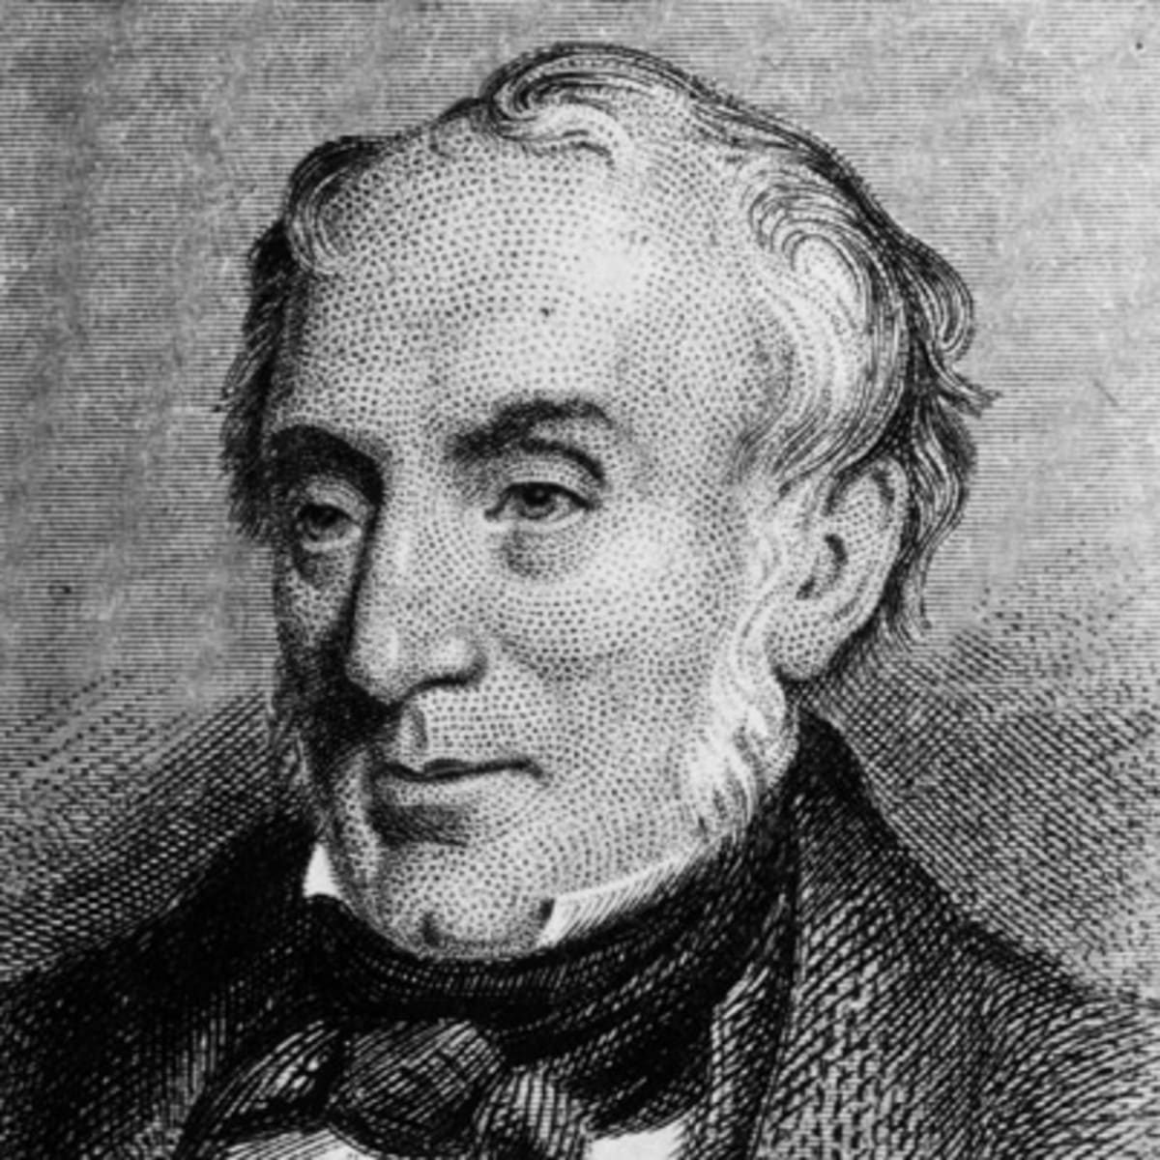
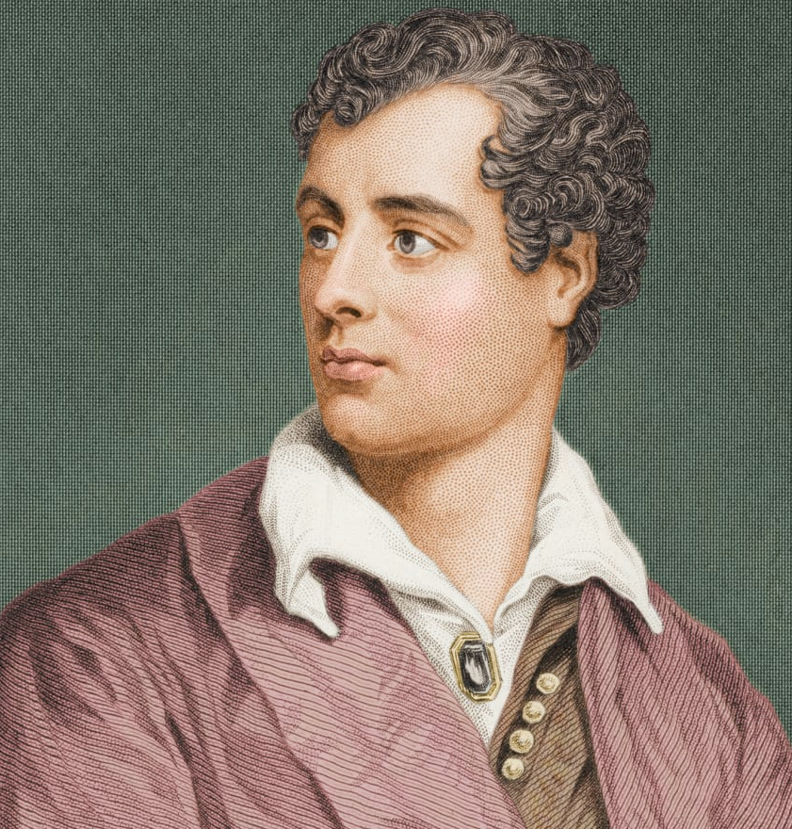
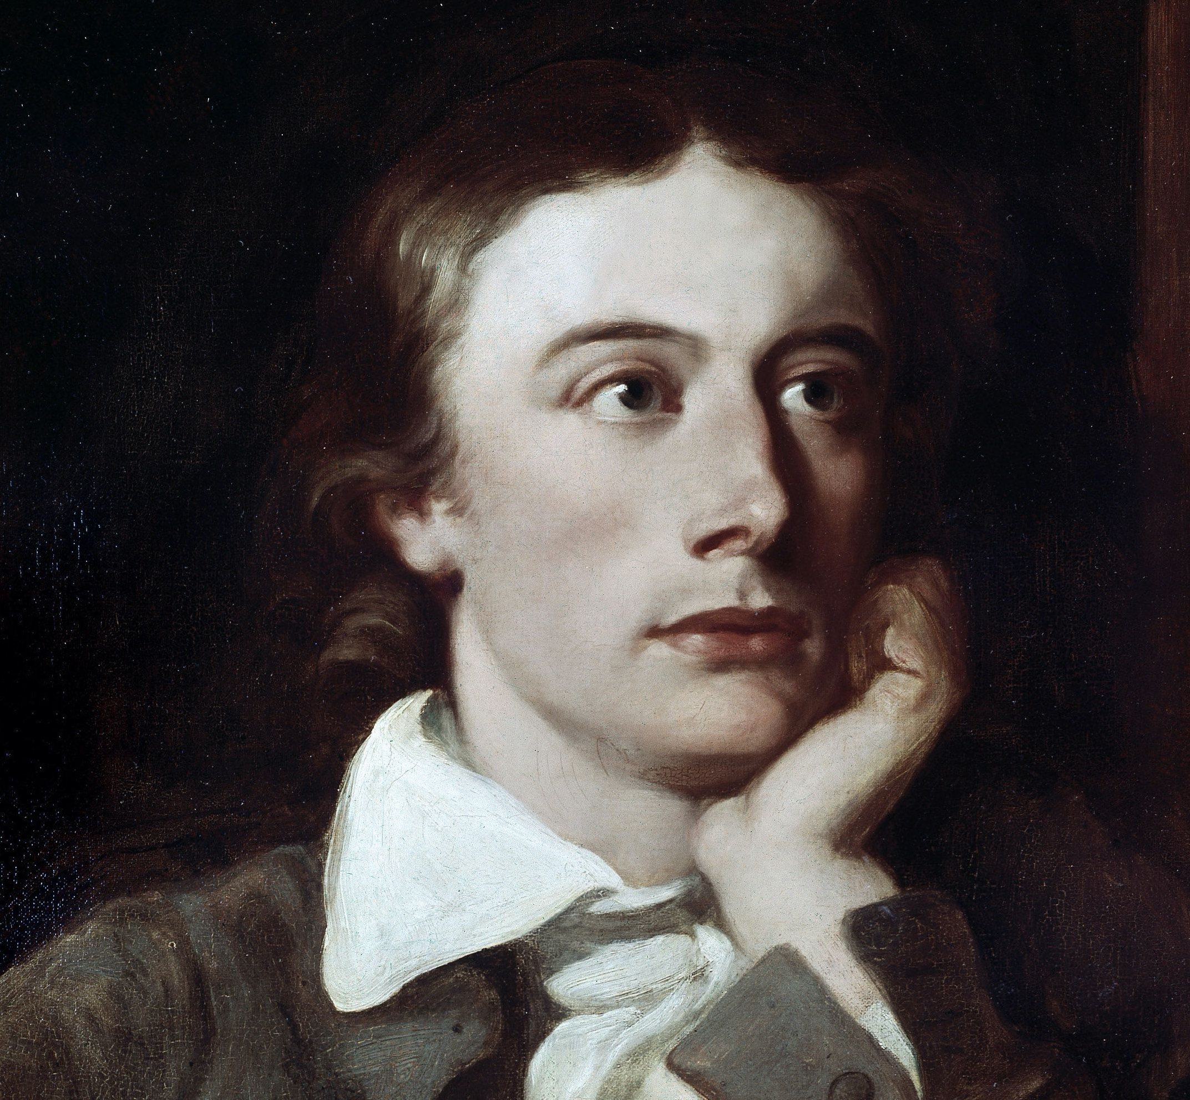
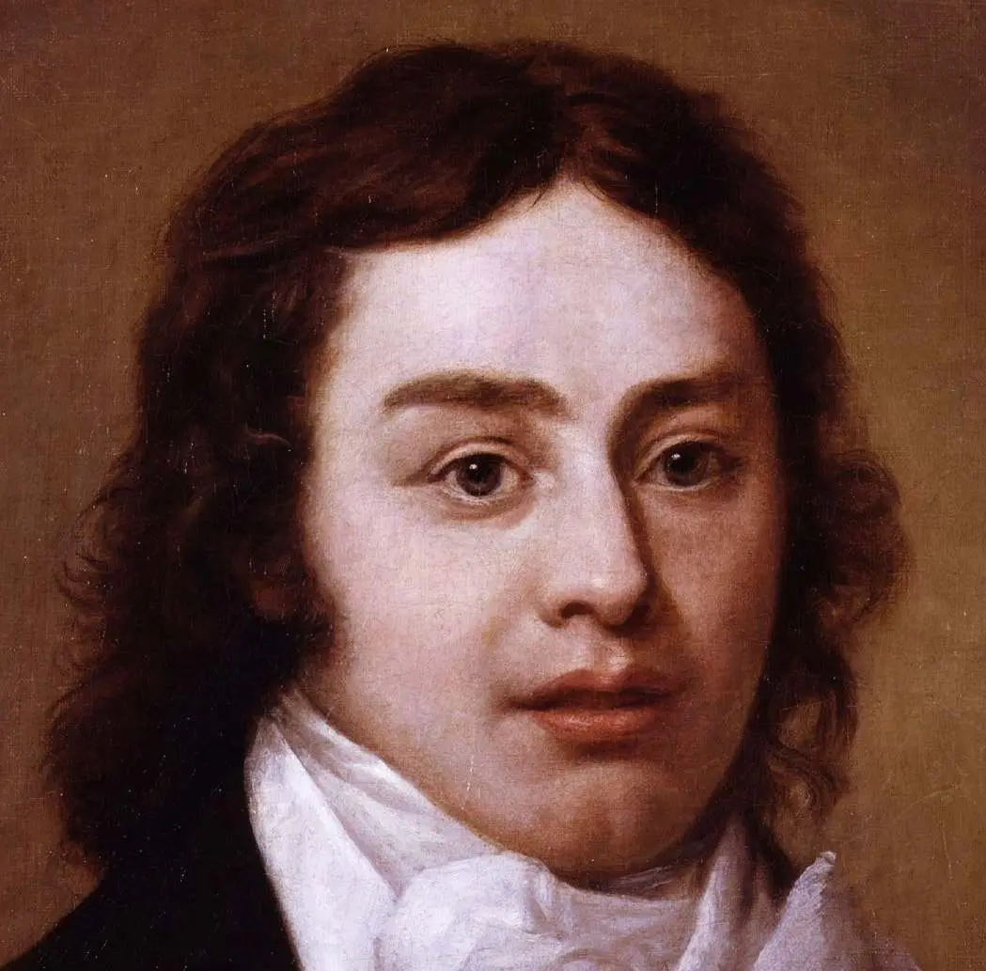
HT3 Year 7: Romantic Poetry
Knowledge Organiser
Poem Summary & Key Quotations
Poem Summary & Key Quotations
‘Sonnet X’ by John Keats | ‘Sonnet X’ by John Keats,
John Keats 1795 - 1821 | Keats’ poem celebrates the pastoral and nature – especially when someone has been in the city for a long time. The experience is almost spiritual. As sonnets are often associated with love, it can be seen as a love poem about nature.
“To one who has been long in city pent” |  | This poem opens with someone who has spent a long time in the city – the following lines suggest the emotional and spiritual benefits of the countryside.
“’Tis very sweet to look into the fair And open face of heaven” |  | This metaphor suggests that the open sky (rather than the grey, smokey city sky) is beautiful (“fair”) and brings you close to heaven and God.
“Who is more happy, when, with hearts content, Fatigued he sinks into some pleasant lair Of wavy grass” |  | These lines suggest that lying, tired, in grass makes the person “happy” and “content”
“He mourns that day so soon has glided by” |  | The person is sad and grieves for the day that has “glided by” too soon. “mourns” suggests is it like a great loss.
Wordsworth
Lord Byron
Keats
Coleridge
Extract from ‘Ode: Imitation of Immortality’ by William Wordsworth, 1802
William Wordsworth 1770-1850 | 1770 – 1850. Lived in The Lake District. Famous works include: ‘Daffodils’ & an epic autobiographical poem called ‘The Prelude’. This extract from ‘Ode: Imitation of Immortality’ is about the innocence of childhood and how it is lost when they grow up.
“Heaven lies around us in our infancy!” | “Heaven lies around us in our infancy!” | Wordsworth’s view on childhood is that it is almost heavenly in a way that adulthood is not. The metaphor of ‘Heaven’ connotes God, goodness and purity.
“Shadows of the prison-house begin to close Upon the growing Boy,” | “Shadows of the prison-house begin to close Upon the growing Boy,” | This metaphor is about how growing up restricts the freedom and innocence of children – it is like a “prison-house”, a shadow looming over them.
“But He beholds the light, and whence it flows, He sees it in his joy;” | “But He beholds the light, and whence it flows, He sees it in his joy;” | This quotation suggests that children are able to see the “light” in life and enjoy it (in a way that adults cannot)
“The Youth, who daily farther from the east Must travel, “ | The Youth, who daily farther from the east Must travel, | This quotation is about how people, “Youths” growing older – it uses the metaphor of a day rising in the East to show that they can’t get younger again.
‘Daffodils’ by William Wordsworth, 1804
William Wordsworth 1770-1850 | ‘Daffodils’ is about the beauty of nature, of the pastoral. It was written after Wordsworth and his sister Dorothy saw a ‘long belt’ of daffodils by a lake whilst on a walk in the Lake District. He recalls seeing them & how the memory of them makes him happy.
“I wandered lonely as a cloud” | “Heaven lies around us in our infancy!” | This simile suggests that Wordsworth was alone, and feeling free and light, like a cloud.
“a host, of golden daffodils” | “Shadows of the prison-house begin to close Upon the growing Boy,” | This quotation suggests there are many daffodils, “a host”, and that they are valuable. The adjective ‘golden’ refers to both the colour of the flowers and the fact that they are valuable and precious – like gold.
“I gazed – and gazed” | “But He beholds the light, and whence it flows, He sees it in his joy;” | Wordsworth takes time to look and take in the view of the daffodils. The repetition and dash emphasises this slower pace and contemplation.
“And then my heart with pleasure fills And dances with he daffodils.” | The Youth, who daily farther from the east Must travel, | The memory of the daffodils brings him joy and happiness: “pleasure” and “dances”. “Fills” suggests that his feelings are almost overwhelming.
‘The Raven’ by Samuel Taylor Coleridge
Samuel Taylor Coleridge 1772 - 1834 | ‘The Raven’ is a narrative poem (it tells a story) about man’s effect on nature: a raven builds his nest in an oak tree and when the tree is cut down to make a boat, the Raven’s “young ones were killed”. The Raven gets his revenge when the boat sinks and all aboard drown.
“He picked up the acorn and buried it straight” |  | The Raven plants the acorn – connecting him to the tree that grows as if it is his tree.
“They built them a nest in the topmost bough. And young ones they had, and were happy enow” |  | The Raven and his mate make their home in the tree and are content.
“And their mother did die of a broken heart” |  | The Raven’s mate dies because the babies are killed – because her heart is broken by the loss.
“They had taken his all; and REVENGE WAS SWEET!” |  | “his all” means his family – who have all died. The capitals and exclamation suggest the Raven’s glee at the men’s deaths.
‘She Walks in Beauty’ by Lord Byron
Lord Byron 1788 - 1824 | This love poem by Lord Byron, compares a beautiful woman, who is walking, to a clear night full of bright stars. He compliments her hair and her pure, precious nature. This woman has a peaceful mind and an innocent, loving heart
“like the night Of cloudless climes and starry skies” |  | The simile compares the woman to the clear, starry sky; it suggests heaven. | “So soft, so calm” | The anaphora of “so” emphasises how soft and calm her forehead and cheek are, suggesting her relaxed, good nature.
“Where thoughts serenely sweet express How pure, how dear their dwelling place” |  | Her thoughts and emotions are so pure and show on her face. It is precious, “dear”, and “pure” – good & innocent | “A mind at peace with all below, A heart whose love is innocent!! | Her mind is “peaceful” – calm, idyllic and she has a loving, innocent heart. Byron’s praise is very high.

